Slide 1

“Bangladesh Sports Odyssey: A Tale of Passion and Pride”
“Exploring the Rich Heritage and Future of Sports in Bangladesh”

Slide 2
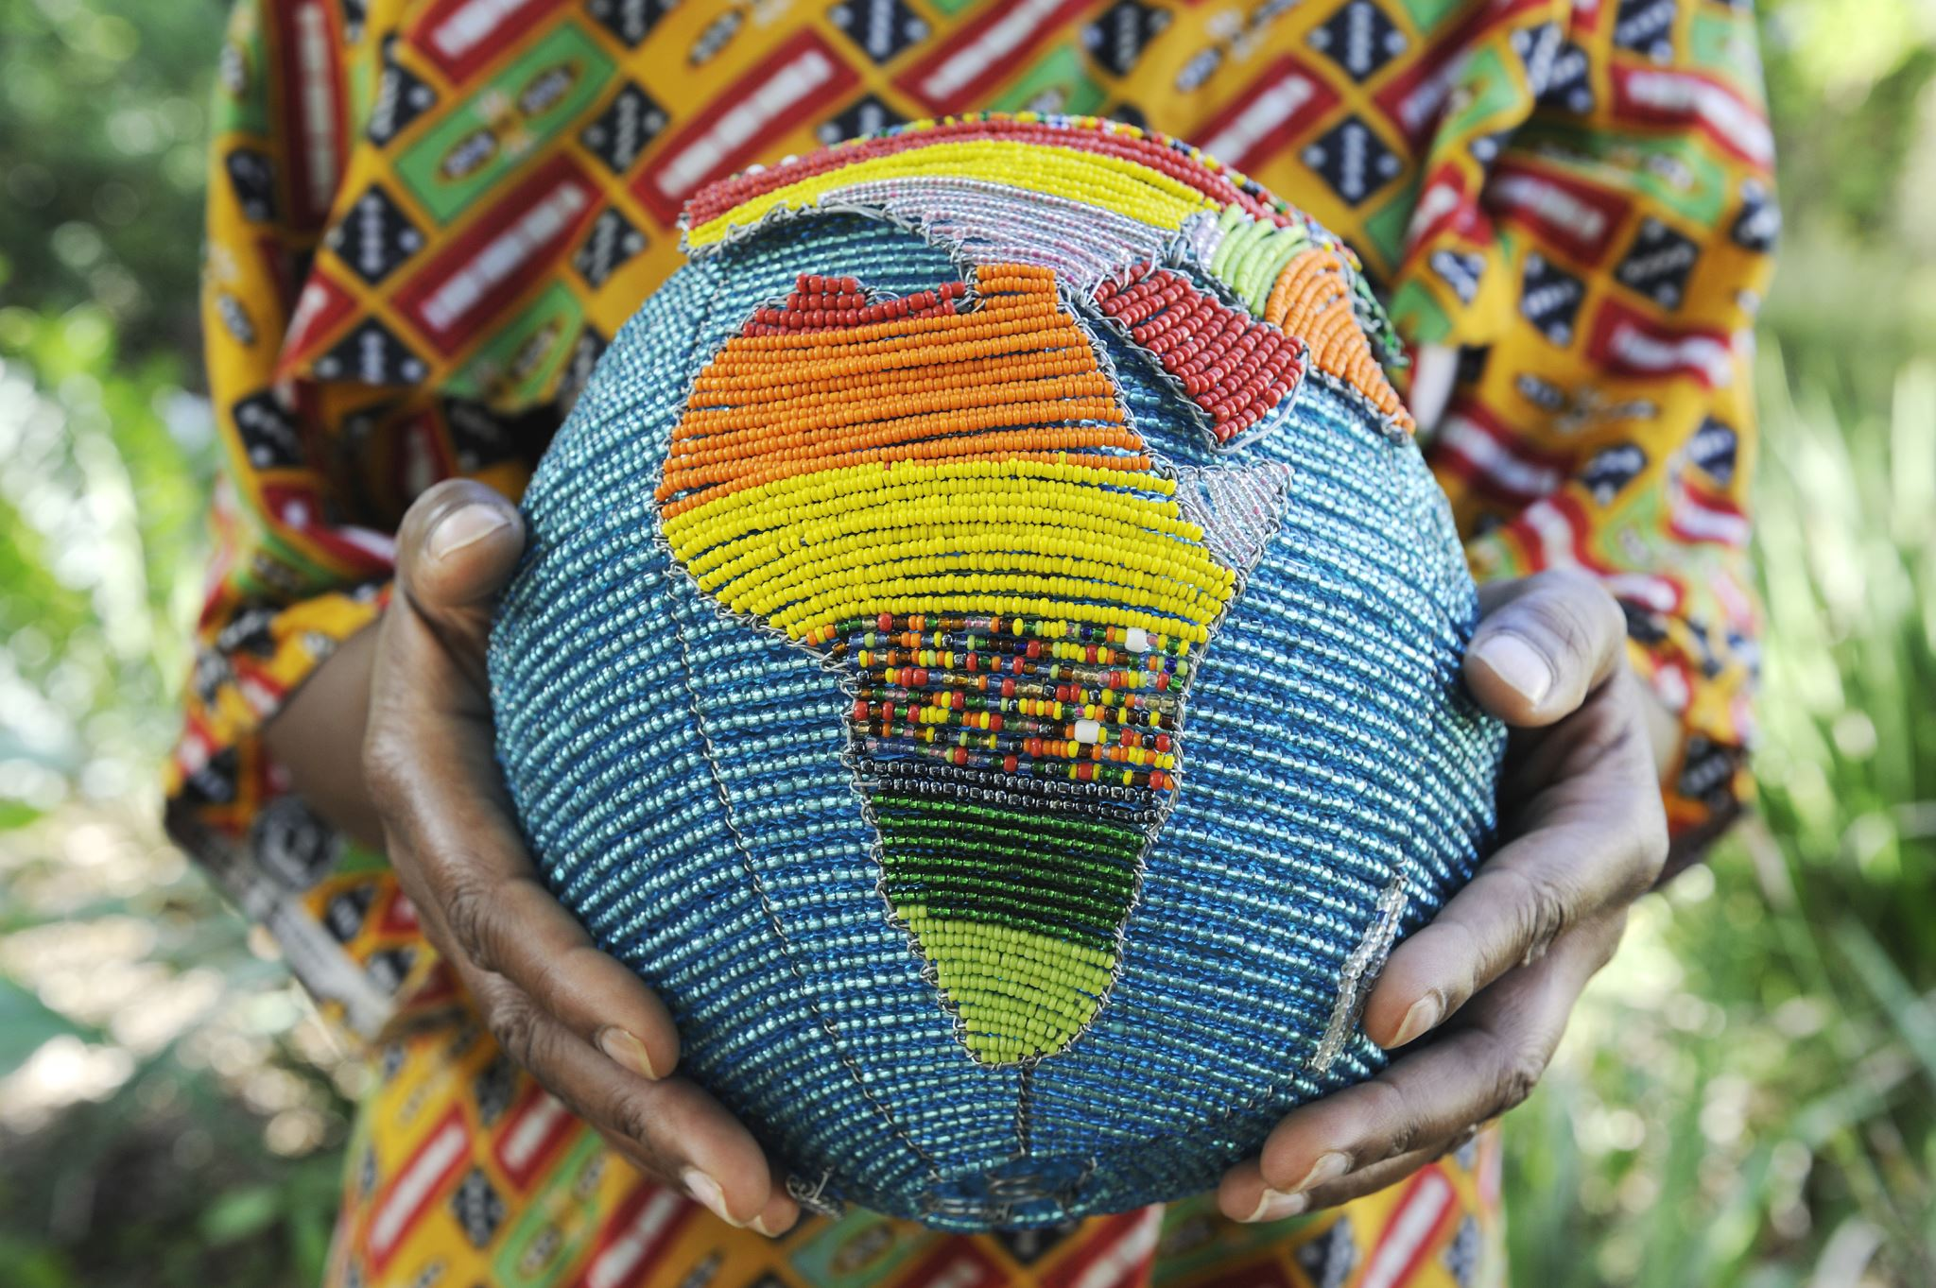
Introduction to Sports in Bangladesh
Sports have a deep-rooted cultural significance in Bangladesh, often acting as a unifying force among diverse communities.Traditional sports like kabaddi and newer sports like cricket reflect the evolution of the country’s sporting landscape.Historical context of sports in Bangladesh, including colonial influences and the establishment of national sports organizations post-independence.

Slide 3
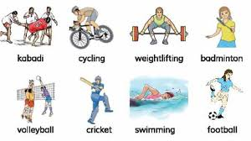
Popular Sports
Cricket: The most popular sport, followed by millions. Major events like the ICC World Cup and BPL draw massive crowds.Football: Long-standing popularity, particularly among the youth. The Bangladesh Premier League has boosted interest.Badminton: Rapidly growing, especially in urban areas; more players are competing internationally.Other Sports: Overview of sports like basketball, volleyball, and traditional games that are part of the cultural fabric.

Slide 4

Cricket: The National Passion
Cricket’s role as a source of national pride and unity, transcending regional and ethnic differences.Key milestones:1999: Bangladesh became a full ICC member.2007: The team qualified for the ICC Cricket World Cup.Performance in T20 tournaments and participation in World Cups.Discussion of domestic cricket, especially the Bangladesh Premier League (BPL) and its impact on the sport.

Slide 5

Football in Bangladesh
Historical Background: Football has a long-standing history in Bangladesh, dating back to colonial times. It has evolved to become one of the most popular sports in the country.Bangladesh Premier League (BPL): The establishment of the BPL has significantly boosted the sport’s popularity, providing a platform for local talent to showcase their skills.Major Clubs:Mohammedan SC and Abahani Limited: Historically significant clubs known for their intense rivalries and dedicated fan bases.Bashundhara Kings:Founded in 2013, this club quickly rose to prominence, winning multiple titles in the Bangladesh Premier League.Known for their strong financial backing and investment in player development.Key achievements include winning the 2019-2020 BPL season and becoming a formidable force in local football.Their focus on youth development and community engagement has made them a model for other clubs.Challenges: The national team faces difficulties, including limited funding, lack of infrastructure, and the need for better talent scouting and development programs.

Slide 6

Badminton and Its Rise
Overview of badminton’s growth in popularity, especially among women and youth.Notable players, such as Ashikur Rahman and Sanjida Sultana, who have made an impact on the international stage.Participation in events like the South Asian Games and BWF tournaments, showcasing the rise of Bangladeshi players.Development of badminton academies and increased investment in coaching.

Slide 7
Kabaddi: Traditional Sport
Kabaddi as a traditional sport that reflects the cultural heritage of Bangladesh.Overview of the rules and format of the game.Major tournaments, including the National Kabaddi League and international competitions.Bangladesh’s historical performance in kabaddi, particularly in South Asian Games.

Slide 8

Athletics and Emerging Talents
Development of athletics programs in schools and colleges, fostering young talent.Highlight key athletes like Shirin Akter (middle-distance runner) and their achievements in international competitions.Participation in regional and international events, such as the Asian Games and Commonwealth Games.Discussion of training facilities and support for athletics in the country.

Slide 9
Government and Institutional Support
Overview of government initiatives to promote sports, including policies and funding.Role of the Bangladesh Olympic Association and various sports federations in organizing events.Importance of sports education in schools and universities, including sports scholarships and facilities.Collaboration with NGOs and private sectors to promote grassroots sports.

Slide 10
Challenges Facing Sports in Bangladesh
Discussion of funding issues at grassroots and elite levels, limiting access to resources.Lack of modern sports infrastructure and training facilities across the country.Governance challenges, including the need for better management and accountability in sports organizations.Awareness and promotion of less popular sports to broaden the sports culture.

Slide 11

Future of Sports in Bangladesh
Opportunities for growth in various sports, including investment in infrastructure and training.Potential for Bangladeshi athletes to achieve international success in various disciplines.Promoting sports tourism through hosting international events and tournaments.Encouraging youth participation in sports through community programs and awareness campaigns.

